Slide 1
CS2523 - Computer Organisation and Assembly Language
Multiplication Assembly Program
Limitation

Slide 2
Multiplication Algorithm

Slide 3
Multiplication Algorithm
Multiplication is a common process that we use, and we were trained to do in early schooling
Remember Multiplying by a digit and then putting a cross and then multiplying with the next digit and putting two crosses and so on and summing the intermediate results in the end
Very familiar process but we never saw the process as an algorithm, and we need to see it as an algorithm to convey it to the processor.

Slide 4
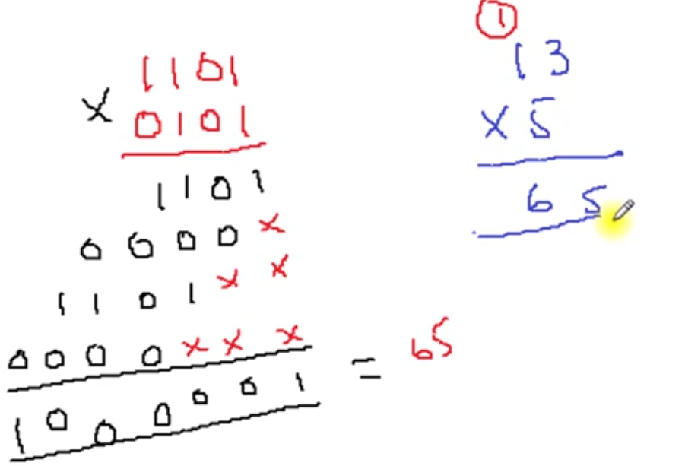
Multiplication Algorithm

Slide 5
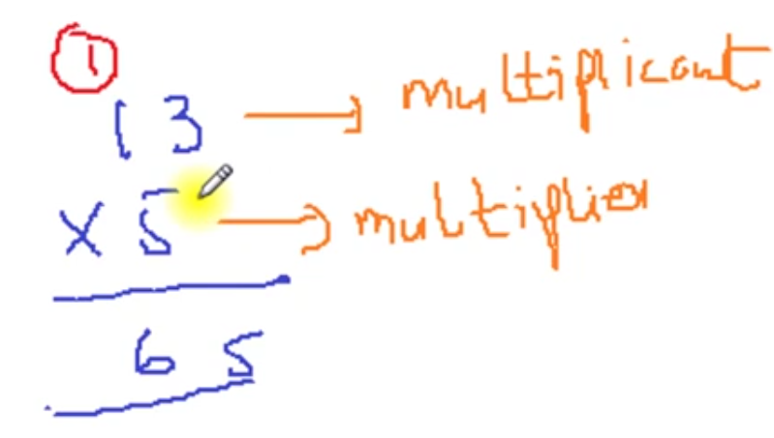
Multiplication Algorithm

Slide 6
Multiplication Algorithm
To highlight important thing in the algorithm we revise it on two 4 bit binary numbers.
The numbers are 1101 i.e. 13 and 0101 i.e. 5. The answer should be 65 or in binary 01000001.
Observe that the answer is twice as long as the multiplier and the multiplicand.

Slide 7
Multiplication Algorithm
We take the first digit of the multiplier and multiply it with the multiplicand. As the digit is one, the answer is the multiplicand itself. So we place the multiplicand below the bar.
Before multiplying with the next digit a cross is placed at the right most place on the next line and the result is placed shifted one digit left. However since the digit is zero, the result is zero.
Next digit is one, multiplying with which, the answer is 1101. We put two crosses on the next line at the right most positions and placed the result there shifted two places to the left.
The fourth digit is zero, so the answer 0000 is placed with three crosses to its right.

Slide 8
Multiplication Algorithm
Observe the beauty of binary base, as no real multiplication is needed at the digit level.
If the digit is 0 the answer is 0 and if the digit is 1 the answer is the multiplicand itself.
Also Observe that for every next digit in the multiplier the answer is written shifted one more place to the left. No shifting for the first digit, once for the second, twice for the third and thrice for the fourth one.
Adding all the intermediate answers, the result is 01000001=65 as desired. Crosses are treated as zero in this addition

Slide 9
Multiplication Algorithm
Before formulating the algorithm for this problem,
We need some more instructions that
Can shift a number so that we use this instruction for our multiplicand shifting and also some way to check the bits of the multiplier one by one.

Slide 10
Multiplication In Assembly Language

Slide 11
Multiplication Algorithm
In the multiplication algorithm discussed above, we revised the way we multiplied number in lower classes, and gave an example of that method on binary numbers.
We make a simple modification to the traditional algorithm before we proceed to formulate it in assembly language

Slide 12
Multiplication Algorithm – Traditional Algorithm
In the Traditional Algorithm, we calculate all intermediate answers and then sum them to get the final answer.
Hint for new Algorithm:
If we add every intermediate answer to accumulate the result, the result will be same in the end, except that we do not have to remember a lot of intermediate answers during the whole multiplication.

Slide 13
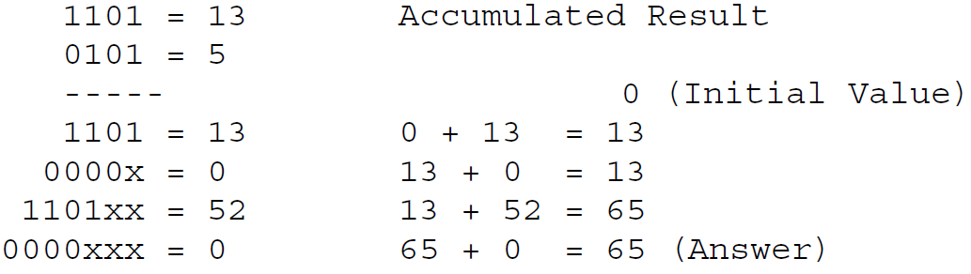
Multiplication Algorithm – New Algorithm
The multiplication with the new algorithm is shown below:

Slide 14
Multiplication Algorithm
We try to identify steps of our algorithm.
First we set the result to zero.
Then we check the right most bit of multiplier. If it is one add the multiplicand to the result, and if it is zero perform no addition.
Left shift the multiplicand before the next bit of multiplier is tested.
The left shifting of the multiplicand is performed regardless of the value of the multiplier’s right most bit. Just like the crosses in traditional multiplication are always placed to mark the ones, tens, thousands, etc.
Then check the next bit and if it is one add the shifted value of the multiplicand to the result.
Repeat for as many digits as there are in the multiplier, 4 in our example.

Slide 15
Multiplication Algorithm
Formulating the steps of the algorithm we get:
Shift the multiplier to the right.
If CF=1 add the multiplicand to the result.
Shift the multiplicand to the left.
Repeat the algorithm for as many digits as there are in the multiplier, 4 in our example.
For an 8 bit multiplication, the algorithm will be repeated 8 times and for a 16 bit multiplication it will be repeated 16 times, Whatever the size of the multiplier is.

Slide 16
Multiplication Algorithm
The algorithm uses the fact that shifting right forces the right most bit to drop in the Carry Flag.
If we test the carry flag using JC we are effectively testing the right most bit of the multiplier.
Another shifting will cause the next bit to drop in the next iteration and so on. So our task of checking bits one by one is satisfied using the shift operation.
There are many other methods to do this bit testing as well, however we exemplify one of the methods in this example.

Slide 17
Multiplication Algorithm
In the first iteration there is no shifting just like there is no cross in traditional multiplication in the first pass.
Therefore we placed the left shifting of the multiplicand after the addition step.
However the right shifting of multiplier must be before the addition as the addition step’s execution depends upon its result.

Slide 18
Multiplication Algorithm
We introduce an assembly language program to perform this 4 bit multiplication.
The algorithm is extensible to more bits with few modifications.
For now we do a 4 bit multiplication to keep the algorithm simple.

Slide 19
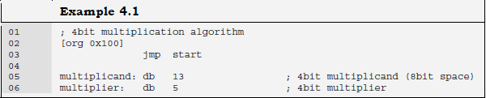
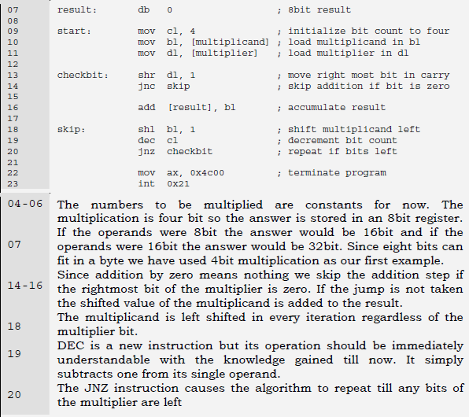
Multiplication Algorithm

Slide 20
Multiplication Algorithm
Inside the debugger observe the working of the SHR and SHL instructions.
The SHR instruction is effectively dividing its operand by two and the remainder is stored in the carry flag from where we test it.
The SHL instruction is multiplying its operand by two so that it is added at one place more towards the left in the result.

Slide 21
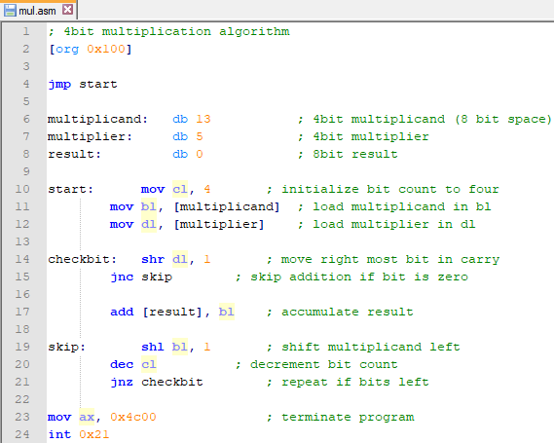
Multiplication Assembly Program

Slide 22
Extended Operations

Slide 23
Extended Operations
We performed a 4 bit multiplication to explain the algorithm however the real advantage of the computer is when we ask it to multiply large numbers. Numbers whose multiplication takes real time.
If we have an 8 bit number we can do the multiplication in word registers, but are we limited to word operations?
What if we want to multiply 32 bit or even larger numbers?
We are certainly no limited.

Slide 24
Extended Operations
Assembly language only provides us the basic building blocks.
We build a plaza out of these blocks, or a building, or a classic piece of architecture is only depend on our imagination.
With our logic we can extend these algorithms as much as we want.

Slide 25
Extended Operations
Our next example will be multiplication of 16 bit numbers to produce a 32 bit answer.
However for a 32 bit answer we need a way to shift a 32 bit number and a way to add 32 bit numbers.
We cannot depend on 16 bit shifting as we have 16 significant bits in our multiplicand and shifting any bit towards the left may drop a valuable bit causing a totally wrong result.
A valuable bit means any bit that is one.
Dropping a zero bit doesn’t cause any difference.
So we place the 16 bit number in 32 bit space with the upper 16 bits zeroed so that the sixteen shift operations don’t cause any valuable bit to drop.

Slide 26
Extended Operations
Even though the numbers were 16 bit we need 32 bit operations to multiply correctly.
To clarify this necessity, we take example of a number 40000 or 9C40 in hexadecimal. In binary it is represented as 1001110001000000.
To multiply by two we shift it one place to the left.
The answer we get is 0011100010000000 and the left most one is dropped in the carry flag.
The answer should be the 17 bit number 0x13880 but it is 0x3880, which are 14464 in decimal instead of the expected 80000.
We should be careful of this situation whenever shifting is used.

Slide 27

Extended Shifting
Using our basic shifting and rotation instructions we can effectively shift a 32 bit number in memory word by word.
We cannot shift the whole number at once since our architecture is limited to word operations.
The algorithm we use consists of just two instructions and we name it extended shifting.

Slide 28
Extended Shifting
The DD directive reserves a 32 bit space in memory, however the value we placed there will fit in 16 bits. So we can safely shift the number left 16 times.
The least significant word is accessible at num1 and the most significant word is accessible at num1+2.
The two instructions are carefully crafted such that the first one shifts the lower word towards the left and the most significant bit of that word is dropped in carry.
With the next instruction we push that dropped bit into the least significant bit of the next word effectively joining the two 16 bit words.
The final carry after the second instruction will be the most significant bit of the higher word, which for this number will always be zero.

Slide 29
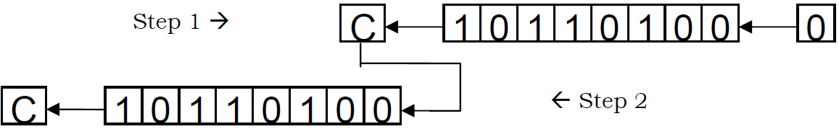
Extended Shifting
The following illustration will clarify the concept. The pipe on the right contains the lower half and the pipe on the left contains the upper half.
The first instruction forced a zero from the right into the lower half and the left most bit is saved in carry, and from there it is pushed into the upper half and the upper half is shifted as well.

Slide 30
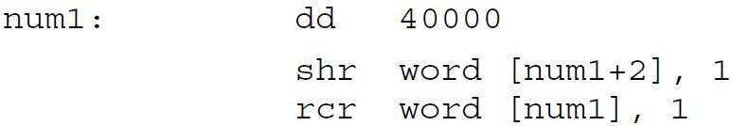
Extended Shifting
For shifting right the exact opposite is done however care must be taken to shift right the upper half first and then rotate through carry right the lower half for obvious reasons.
The instructions to do this are:

Slide 31
Extended Shifting
The same logic has worked. The shift placed the least significant bit of the upper half in the carry flag and it was pushed from right into the lower half.
For a signed shift we would have used the shift arithmetic right instruction instead of the shift logical right instruction.

Slide 32
Extended Shifting
The extension we have done is not limited to 32 bits.
We can shift a number of any size say 1024 bits.
The second instruction will be repeated a number of times and we can achieve the desired effect.
Using two simple instructions we have increased the capability of the operations to effectively an unlimited number of bits.
The actual limit is the available memory as even the segment limit can be catered with a little thought.

Slide 33
Extended Addition And Subtraction
We also need 32 bit addition for multiplication of 16 bit numbers.
The idea of extension is same here. However we need to introduce a new instruction at this place.
The instruction is ADC or “add with carry”.
Normal addition has two operands and the second operand is added to the first operand.
However ADC has three operands.
The third implied operand is the carry flag.
The ADC instruction is specifically placed for extending the capability of ADD.
Numbers of any size can be added using a proper combination of ADD and ADC.

Slide 34
Extended Addition And Subtraction
All basic building blocks are provided for the assembly language programmer, and the programmer can extend its capabilities as much as needed by using these fine instructions in appropriate combinations.
Further clarifying the operation of ADC,
Consider an instruction “ADC AX, BX”.
Normal addition would have just added BX to AX.
However ADC first adds the carry flag to AX and then adds BX to AX.
Therefore the last carry is also included in the result.

Slide 35
Extended Addition And Subtraction - Algorithm
The algorithm should be apparent by now.
The lower halves of the two numbers to be added are first added with a normal addition.
For the upper halves a normal addition would lose track of a possible carry from the lower halves and the answer would be wrong.
If a carry was generated it should go to the upper half.
Therefore the upper halves are added with an addition with carry instruction.
Since one operand must be in register, ax is used to read the lower and upper halves of the source one by one.
The destination is directly updated.

Slide 36
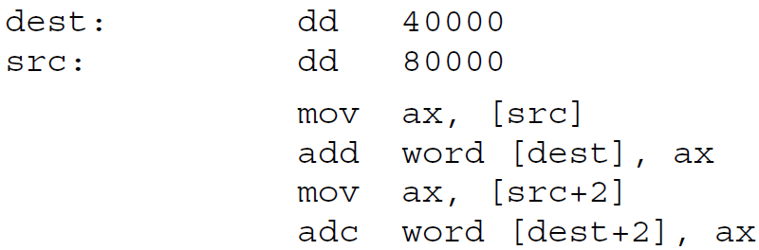
Extended Addition And Subtraction - Algorithm
The set of instructions goes here:
To further extend it, more addition with carries will be used.
However the carry from last addition will be wasted as there will always be a size limit where the results and the numbers are stored.
This carry will remain in the carry flag to be tested for a possible overflow.

Slide 37
Extended Addition And Subtraction
For Subtraction the same logic will be used and just like addition with carry there is an instruction to subtract with borrows called SBB.
Borrow in the name means the carry flag is used. Or we can say that the carry flag holds the carry for addition instructions and the borrow for subtraction instructions.
Also the carry is generated at the 17th bit and the borrow is also taken from the 17th bit.
Also there is no single instruction that needs borrow and carry in their independent meanings at the same time.
Therefore it is logical to use the same flag for both tasks.

Slide 38
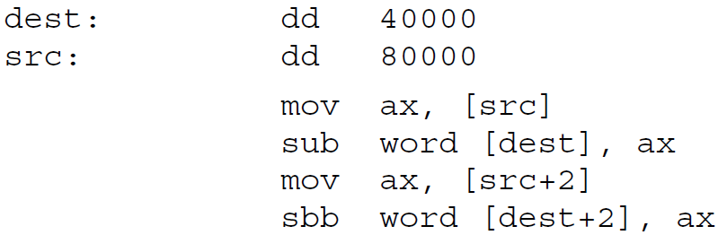
Extended Addition And Subtraction - Algorithm
We extend Subtraction with a very similar algorithm.
The lower halves must be subtracted normally while the upper halves must be subtracted with a subtract with borrow instruction so that if the lower halves needed a borrow, a one is subtracted from the upper halves. The algorithm is as under:

Slide 39
Extended Multiplication
We use extended shifting and extended addition to formulate our algorithm to do extended multiplication.
The multiplier is still stored in 16 bits since we only need to check its bits one by one.
The multiplicand however cannot be stored in 16 bits otherwise on left shifting its significant bits might get lost.
Therefore it has to be stored in 32 bits and the shifting and addition used to accumulate the result must be 32 bits as well.

Slide 40
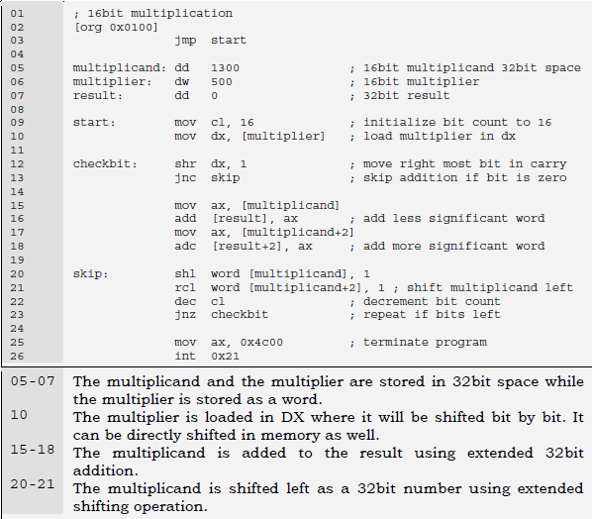
Extended Multiplication - Algorithm

Slide 41
Extended Multiplication
The multiplicand will occupy the space from 0103-0106,
The multiplier will occupy space from 0107-0108 and the result will occupy the space from 0109-010C.
Inside the debugger observe the changes in these memory locations during the course of the algorithm.
The extended shifting and addition operations provide the same effect as would be provided if there were 32 bit addition and shifting operations available in the instruction set.
At the end of the algorithm the result memory locations contain the value 0009EB10 which is 65000 in decimal; the desired answer.
Also observe that the number 00000514 which is 1300 in decimal, our multiplicand, has become 05140000 after being left shifted 16 times.

Slide 42
Extended Multiplication
Our extended shifting has given the same result as if a 32 bit number is left shifted 16 times as a unit.
There are many other important applications of the shifting and rotation operations in addition to this example of the multiplication algorithm.

